Slide 1

Week 5
Time management

Slide 2
Weekly Recap
Questions?
Examples of Milestones - Discussion
Quiz Review – Posted on Blackboard

Slide 3
Task Types
Defining the type of task will assist in scheduling and resource allocation
‘Fixing’ a task type will alter the way a PMIS processes the project information

Slide 4

Task Types
Fixed Work – the total amount of labour hours required to complete a task
Fixed Duration – the elapsed time the task will take to complete
Fixed Units – the number of resources, and/or the percentage of a resource’s time that will be assigned

Slide 5
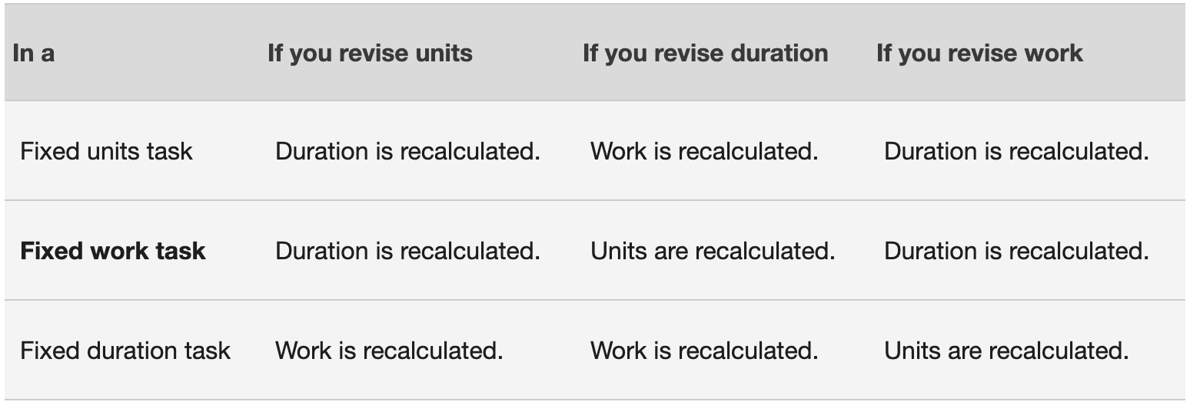
How task types change your schedule

Slide 6
The Scheduling Formula
An equation used to identify how changes to the fixed tasks will be translated
Important for cost management - Identifies hours of billable work for each resource per task
Used when durations are predetermined
Duration*Unit=Work
Amount of time for task * the number of people required = number of work days per person
Example: 5 days required to complete the task * 2 people assigned to the task = 10 work days

Slide 7

The Scheduling Formula
In order to calculate the different task types, the formula must be rearranged
Duration*Unit=Work
Work / Unit = Duration
Work / Duration = Units

Slide 8

PERT
Program Evaluation Review Technique
Helps define a realistic duration
Used when
  Durations are uncertain
  There is a high confidence in the most likely scenario variable
Estimates
  Shortest possible time a task will take
  Most probable amount of time
  Longest amount of time
Calculated backwards from a fixed end date

Slide 9
PERT/BETA
PERT – optimistic + (4*likely) + pessimistic/6
Example:
Optimistic = 20 days
Likely = 30 days
Pessimistic = 60 days
20 + (30*4) + 60 / 6 = Expected Time
20 + 120 + 60 / 6 = Expected Time
200 / 6 = 33.3 days
The estimated duration of the task using PERT is 20 days
t = O + (4*m) + p
6

Slide 10

Controlling the Schedule
When the project schedule must be shortened
Adjustments can be made to the timeline in order to achieve an earlier project completion date

Slide 11
Crashing
A technique used to shorten the schedule duration for the least incremental cost by adding resources.
Examples:
  Approving overtime,
  Bringing in additional resources
  Paying to expedite delivery to activities on the critical path
Crashing works only for activities on the critical path where additional resources will shorten the activity’s duration.
Cons: It does not always produce a viable alternative and may result in increased risk and/or cost.
PMBOK 6, 215

Slide 12
Fast Tracking
A schedule compression technique in which activities or phases normally done in sequence are performed in parallel for at least a portion of their duration
Examples:
  In a project to launch a new brand, having one team start on the web design while another team works to finalize the brand logo and colours
Fast tracking only works when activities can be overlapped to shorten the project duration on the critical path.
Cons: May result in rework and increased risk, and may also increase project costs.
PMBOK 6, 215

Slide 13
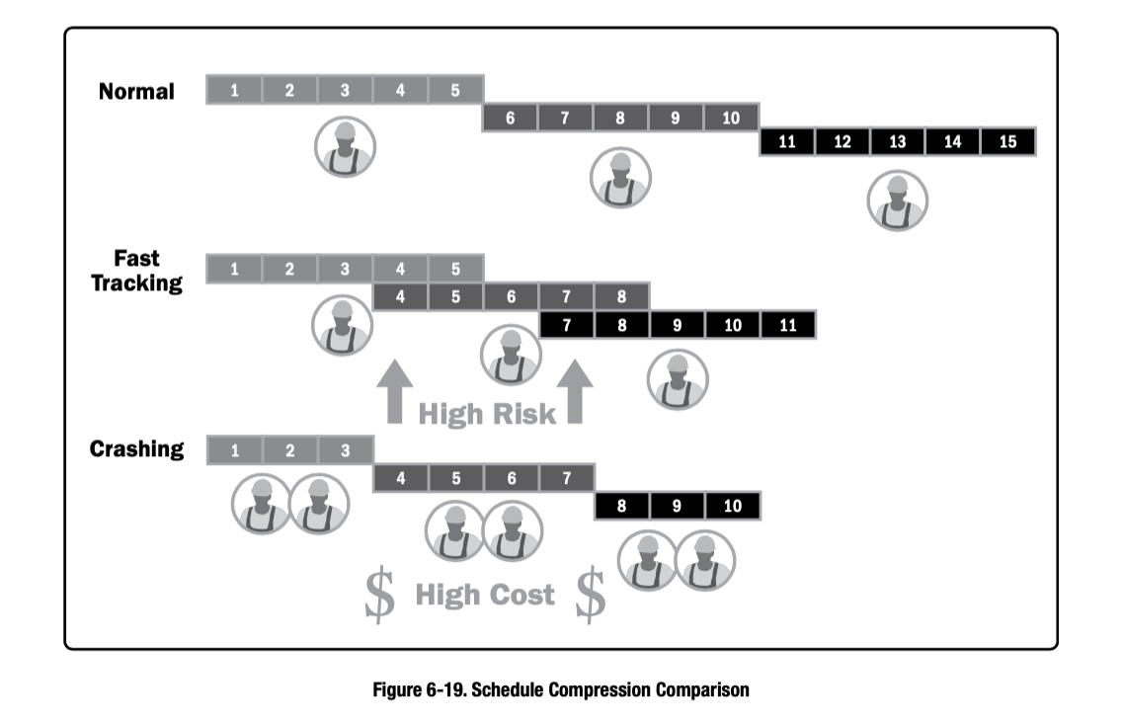
PMBOK 6, 215

Slide 14
Midterm Exam Reminder
Next week, October 14, 2021, at 8am EST you will write the Midterm Exam
Please ensure you are available during class time.
You will have 90mins (1.5hrs) to complete the exam.
Class policy is strictly in effect. Any discussion/sharing of answers can result in a grade of zero.
Anticipate approximately 25-30 multiple choice questions based on Lectures 1 through 5 (this includes today’s lecture)
Exam is worth 15% of your grade.
Any issues with Blackboard, please contact the help desk

Slide 15

For Next Class
Work on in-class activity
  Group assignment, one member submits a copy
  Due October 21, 11:59 PM EST
Module 4
No quiz this week, study for your Midterms!

Slide 16
In-Class Assignment
In a group, develop a project schedule – groups listed on Blackboard
Provide a brief description of the project
Provide a copy of the schedule with activity durations, resources and resource types
  Can be done in a spreadsheet, a Gantt chart or a diagram
Define the project start date, end date and identify any milestones
Develop a second copy of the schedule, identifying where crashing and fast-tracking could be used to shorten the project timeline
Write 1 paragraph for each tactic explaining where it would be used, how it would be done and why it would be helpful.
Deliverables: A copy of original schedule, a copy of updated schedule , and written component
Please ensure that each member submits their assignment to Blackboard by Thursday, October 21st , 11:59 PM EST

